Slide 1
Module 3: Managing Cybersecurity
Week 6

Slide 2
Overview
What is Cybersecurity?
Why it is important?
Different ways of cyberattacks
Steps to avoid/prevent cyberattacks
Applications in real-life

Slide 3
Cybersecurity and it’s importance
With cybercrime damages projected to reach 10.5 trillion USD by year 2025, Government agencies organisation across the world are investing in Cybersecurity infrastructure to protect their business and millions of users trust them with their data.
Because of an unprecedented amount of data that being collected, processed and stored on device or clouds services - Cybersecurity plays an important role in securing our works or any other digital infrastructure that we use from unauthorised access or even malicious attacks.

Slide 4
Phishing
According to a 2019 Verizon report, 32% of all data breaches involved phishing in one way or another.
In addition, 90% of confirmed phishing email attacks occurred in environments that used Secure Email Gateways (SEGs).
Phishing has developed into various highly sophisticated methods since its inception in 1987.
As digital technologies advance, this assault will continue to discover new methods to exploit security vulnerabilities

Slide 5
Phishing
Phishing attacks come in many different forms, differentiating one from a valid email, voice mail, text message, or information request can be difficult.
Some links do not need any input from their victims. Once the victim clicks the link and allows it to execute what it intended to do entirely, without any sign, the victim's data is already in the hands of the hackers.
This way does not only apply to phishing. It can also cause forced installation of ransomware to the victim's computer

Slide 6
Phishing
How you can detect and prevent phishing attacks?
Adopting/Practicing CIA
Validating suspicious emails
To be cautious while opening any links/attachments
Deleting the email and not forwarding it to your friends or colleagues.
Using strong passwords
Reporting to ServiceNow@NTU
Any other?

Slide 7
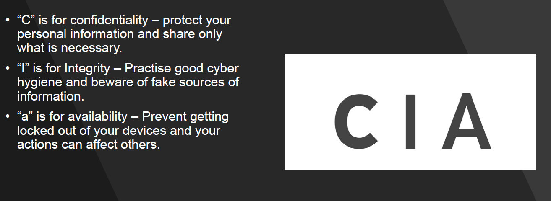
CIA

Slide 8
Data Security
Data can be broadly classified as belonging to an individual or an organisation.
Depending on the type of data we are handling – different levels of security can be implemented.
Four levels of data security possible:
Level 1: Open
Level 2: Restrict
Level 3: Confidential
Level 4: Classified

Slide 9
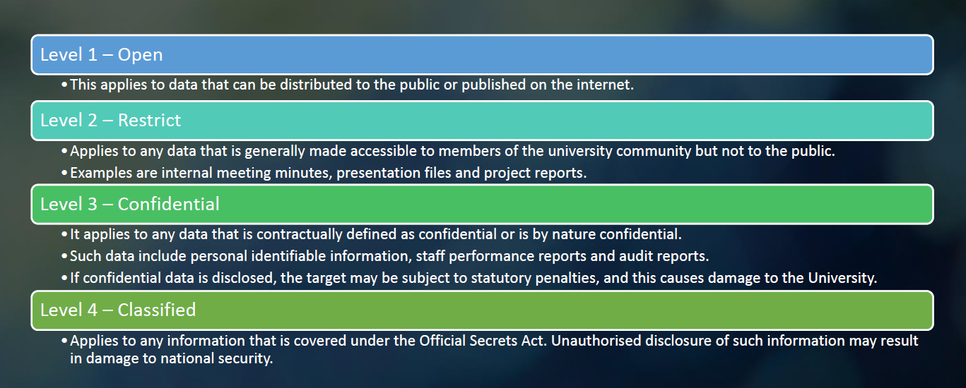
Levels of Data Security

Slide 10
Good/Acceptable Practice
Pay attention to these measures
Lock your workstation when leaving your desk
Adopt a clean-desk policy and keep your desk clear
Send and store work information through organisational accounts
Keep your data storage devices securely
Always choose to use trusted Wi-Fi networks and avoid doing sensitive transactions like internet banking or emailing confidential information.
Always choose to use “BCC” instead of “CC” –when sending a mass-email, to keep their identities confidential.
Be mindful when connecting an external device to your computer as you would not know if it has been compromised by a virus or malware. Do remember to install an anti-virus software on your devices and always ensure that it is up to date.
For more information about the Acceptable IT Usage Policy, refer to the AIUP document in our policy portal.

Slide 11
AIUP
DO’s:
Update your passwords regularly
Always ensure that you keep your password safe
Use MFA
Use the NTU email for all official communications
Use Blind Carbon Copy (BCC) for mass emails
Keep your software updated with security patches
DON’T’s
Don’t share your password with anyone
Don’t forward any University document to your personal email address or online storage that’s not approved by the University
Don’t install software without appropriate licenses
Don’t turn off your anti-virus software or cancel any software updates
Don’t over share information in social media

Slide 12
Module 4 Tutorial Activity
In this week’s activity, you will learn the serious consequences of cyberattack and the need/importance of cybersecurity and the data ethics & security in place.
You all are assigned with few activities to complete in this tutorial class.

